Slide 1

Company Background & Serbia Update
Presented to:
Health Minister Zlatibor Loncar
Belgrade, Serbia
Ministry of Health
August 29, 2014

Slide 2
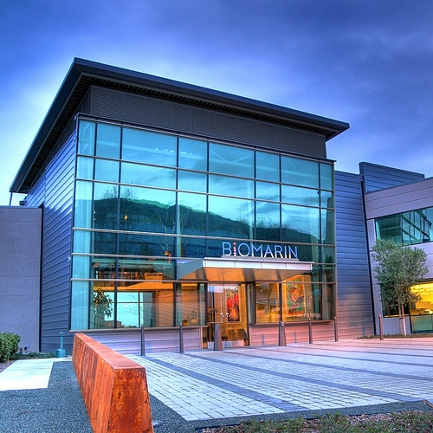
Discussion
Introductions
Update BioMarin
Serbia situation
Morquio syndrome
Vimizim

Slide 3
BioMarin
Matching proven science with proven needs
Established: 1997
Headquarters: Novato, California USA
Employees: 1,000 worldwide
Focus on developing and commercializing innovative therapies for Rare Diseases
Full in-house research and manufacturing
Providing rapid access to treatment for patients with serious unmet medical needs
Notes:
Currently, BioMarin has a worldwide presence, with a strong development and manufacturing group and limited focus on sales and marketing

Slide 4
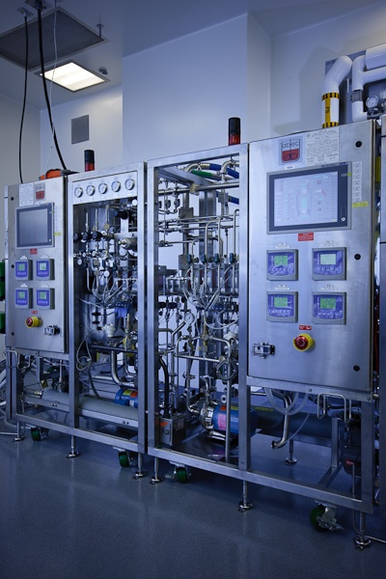


BioMarin Developing, Manufacturing and Commercializing Treatments for Rare Diseases
Products on the Market
  Vimizim® for MPS IV
  Naglazyme® for MPS VI
  Aldurazyme® for MPS I (partnership with Genzyme)
  Kuvan™ for phenylketonuria (PKU) (partnership with Merck Serono)
  Firdapse™ for Lambert-Eaton Myasthenic Syndrome (LEMS)

Slide 5
BioMarin Serbia: Key Activities
There are currently 11 MorquioA patients in the Serbian territory:
9 children / 2 adults
The children are being followed by Dr. Maja DJORDJEVIC, a pediatrician expert in MPS at the pediatrics department
of Mother and Child Health Institute of Serbia "Dr Vukan Cupic“
BioMarin had meetings with N.O.R.B.S and Dr. Maja DJORDJEVIC to better understand the environment of rare diseases in Serbian territory.
Following the meetings BioMarin asked to meet the MoH to discuss the possibilities of bringing these patients onto treatment to minimize the clinical manifestations and disease progression.
Notes:
Currently, BioMarin has a worldwide presence, with a strong development and manufacturing group and limited focus on sales and marketing

Slide 6

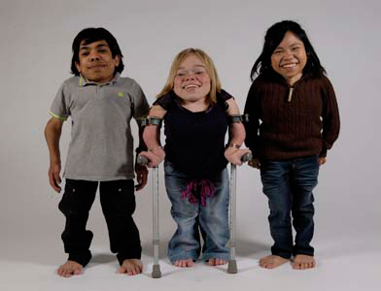
Mucopolysaccharidosis type IVA :
(MPS IV or MorquioA Syndrome)
Autosomal recessive lysosomal storage disorder
Also referred to as Mucopolysaccharidosis IVA
Incidence varies: from 1 in 76,000 live births (Northern Ireland) to 1 in 640,000 live births (western Australia)
Caused by deficient activity of N-acetyl-galactosamine-6-sulfatase (GALNS), an enzyme that catalyzes the breakdown of two glycosaminoglycans (GAGs), keratan sulfate (KS) and chondroitin-6-sulfate (C6S)
Wide variability in clinical presentation and disease severity due to progressive GAG accumulation in tissues

Slide 7
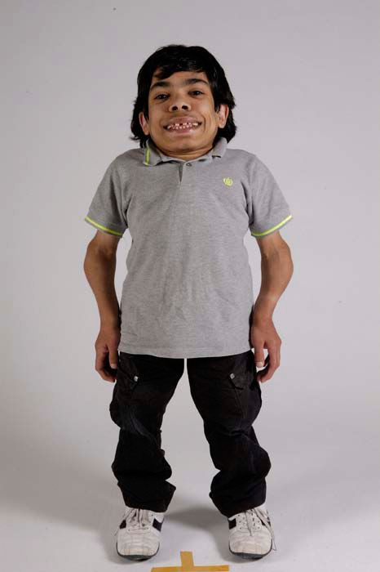
Morquio A is a multisystemic disorder
Clinical signs and symptoms:
Skeletal dysplasia
Short stature
Cervical spine instability
Spinal cord compression
Impaired endurance
Respiratory disease
Hearing loss
Corneal clouding
Heart valvular disease
Dental abnormalities
Normal intelligence

Slide 8
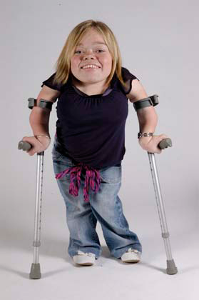

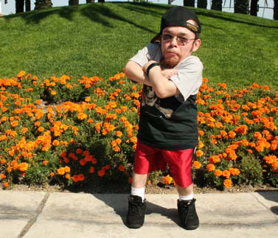
Morquio A is clinically heterogeneous
Over 170 mutations in the GALNS gene give rise to wide
genotypic and phenotypic heterogeneity
The severity of disease is influenced by the time of onset
and depends on the residual enzyme activity
Symptoms develop when residual enzyme activity falls
below a threshold of about 10%

Slide 9

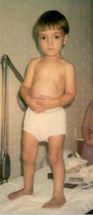


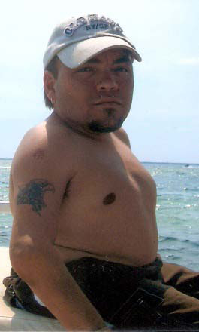
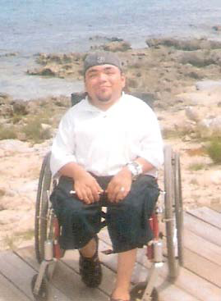
Morquio A is progressive
17yr
4yr
16yr
10yr
28yr
30yr

Slide 10
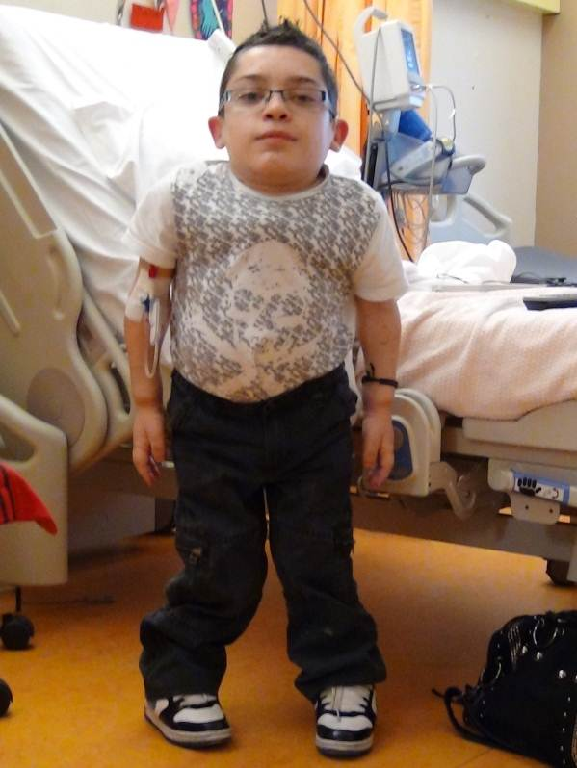
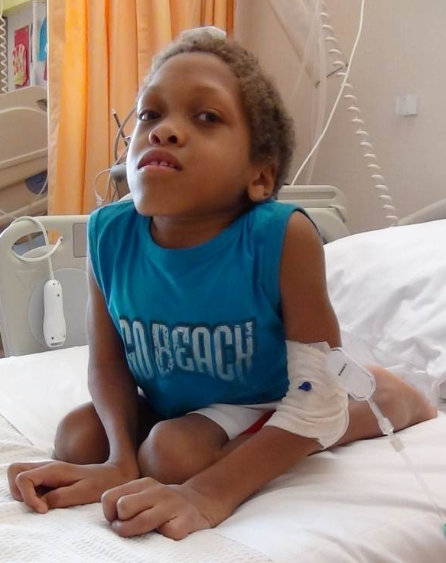
Vimizim for Treatment of MPS IV
Vimizim is the only ERT for MorquioA syndrome
Replaces the deficient enzyme with a recombinant version
Route of Administration: Intravenous (IV) infusion
Dosage Form:
  Buffered solution in 5 mL vials, 5mg/5mL
Dosing Regimen
  2 mg/kg of patient weight diluted in normal saline
  Weekly 4-hour long infusion
  Life long therapy

Slide 11

Thank You!

